Slide 1
Data Riders: Time Series Analysis with Crude Oil Dataset
Presented by:
Santhosh Kumar
Yuvaraj Nachimuthu
Ekta Chaurasia
Avishek Deb
Srinath Ganesh
Smita Jha

Slide 2
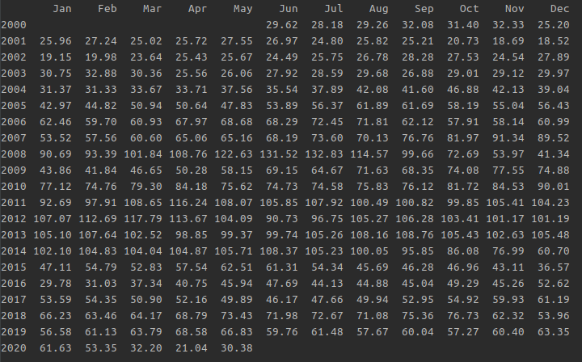
The Data

Slide 3
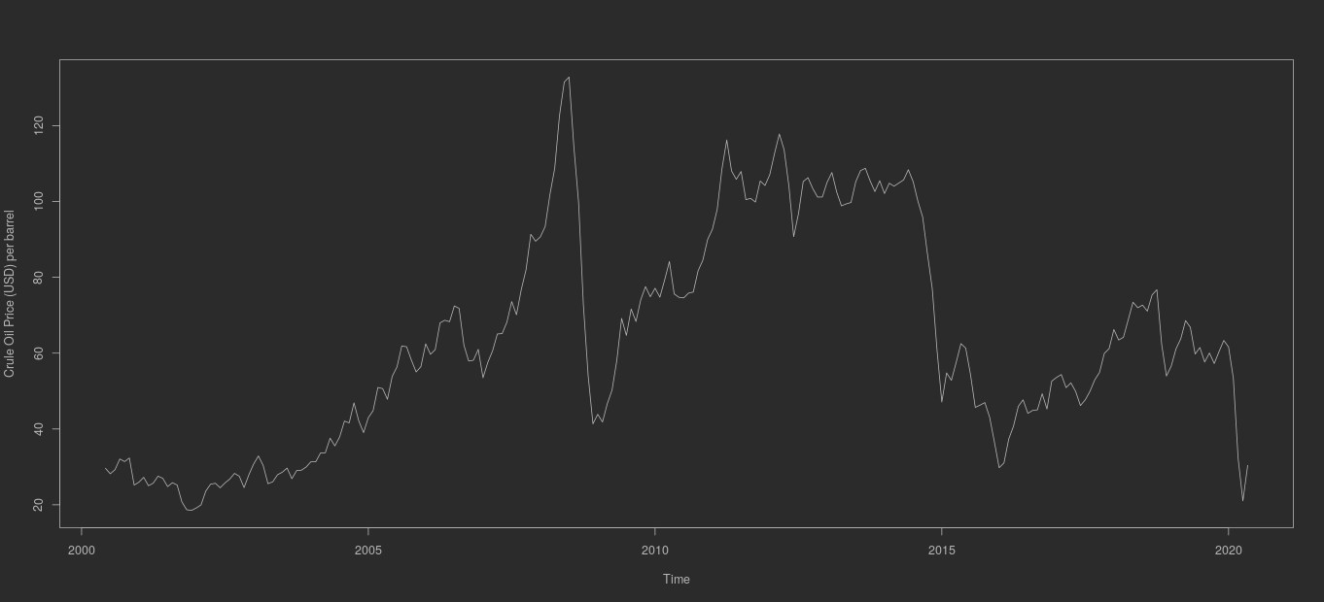
Time Series of the Data

Slide 4
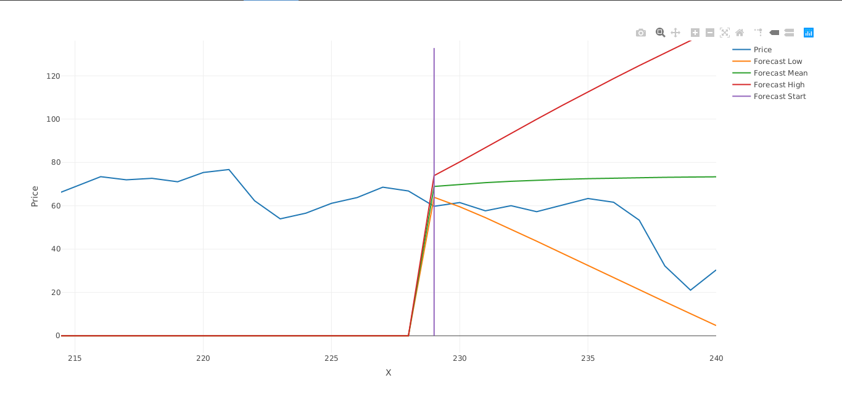
Forecasting with SMA (n=2)
RMSE | 25.24
MAE | 20.35
MAPE | 58.45

Slide 5
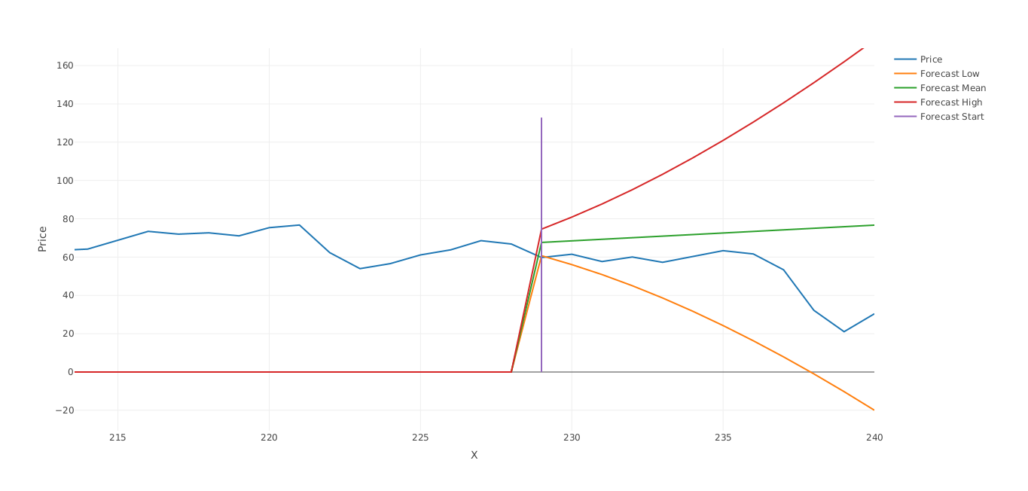
Forecasting with HoltWinters
RMSE | 26.31
MAE | 20.62
MAPE | 60.24

Slide 6

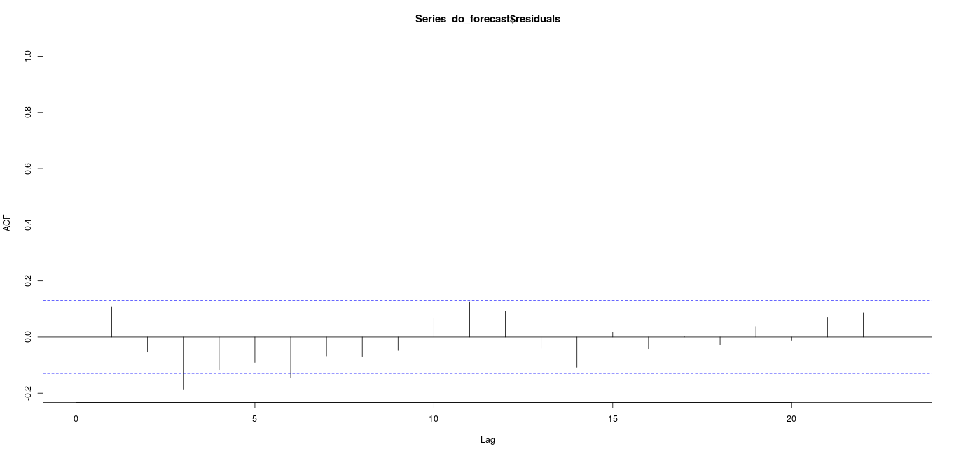
Forecasting with HoltWinters

Slide 7
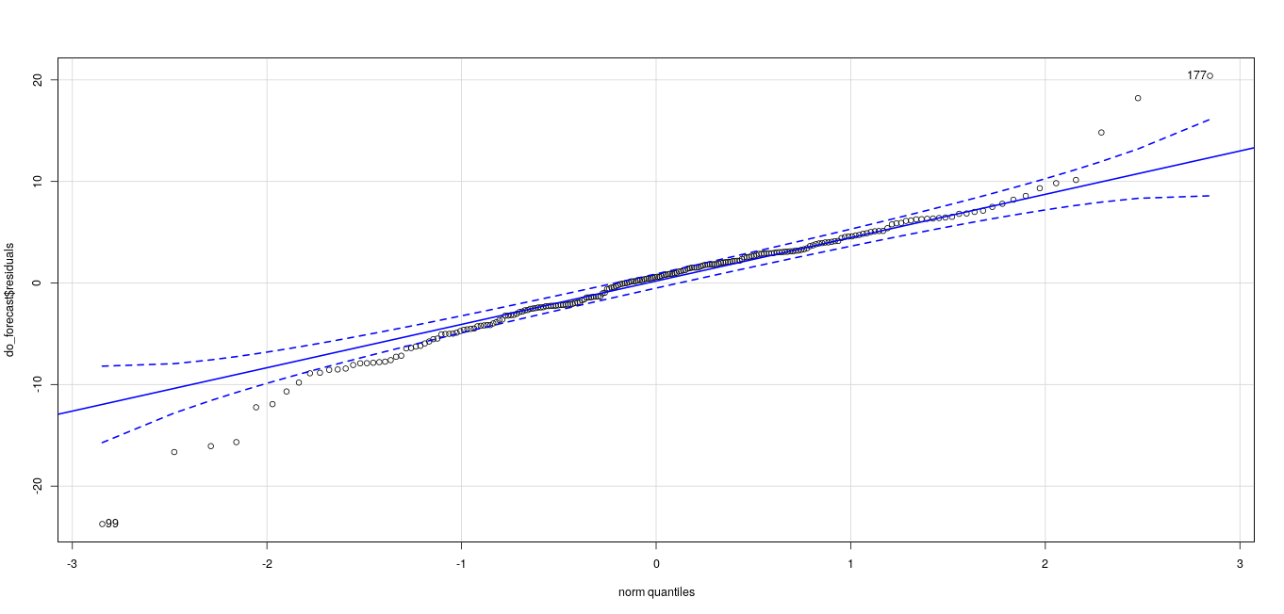
Forecasting with HoltWinters

Slide 8


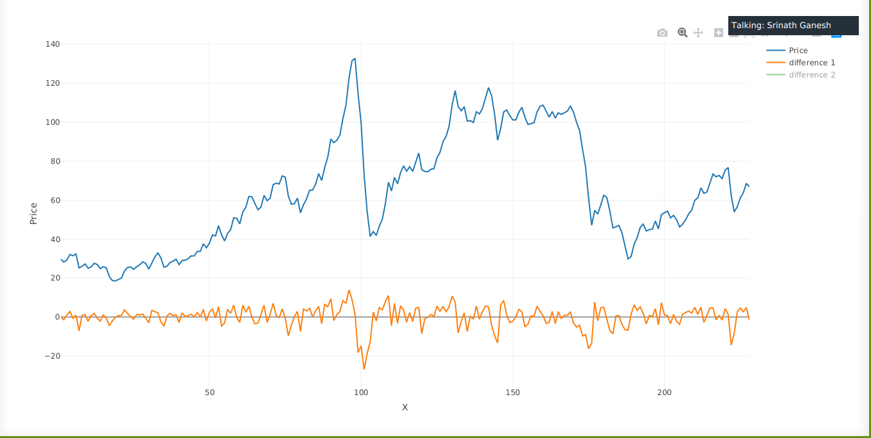
Augmented Dickey-Fuller Test

Slide 9
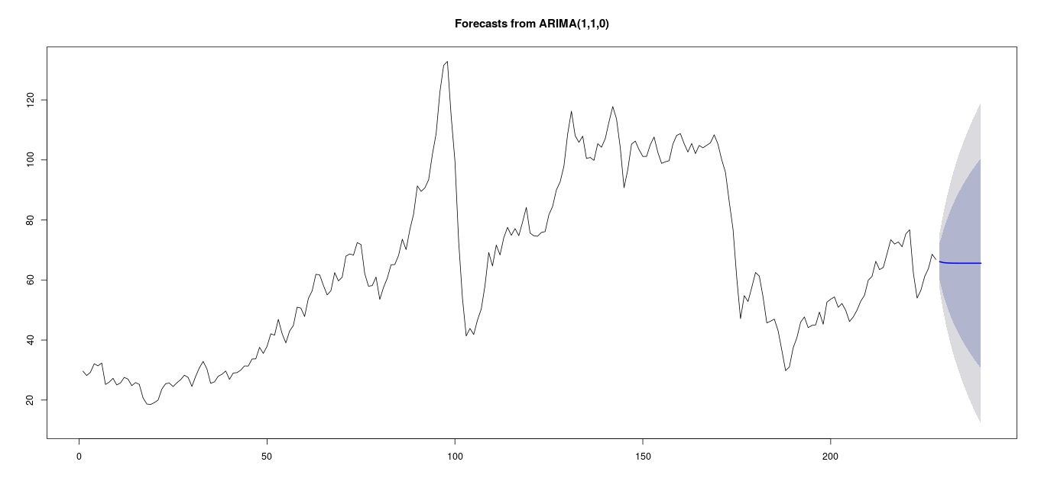
Forecasting with Arima

Slide 10
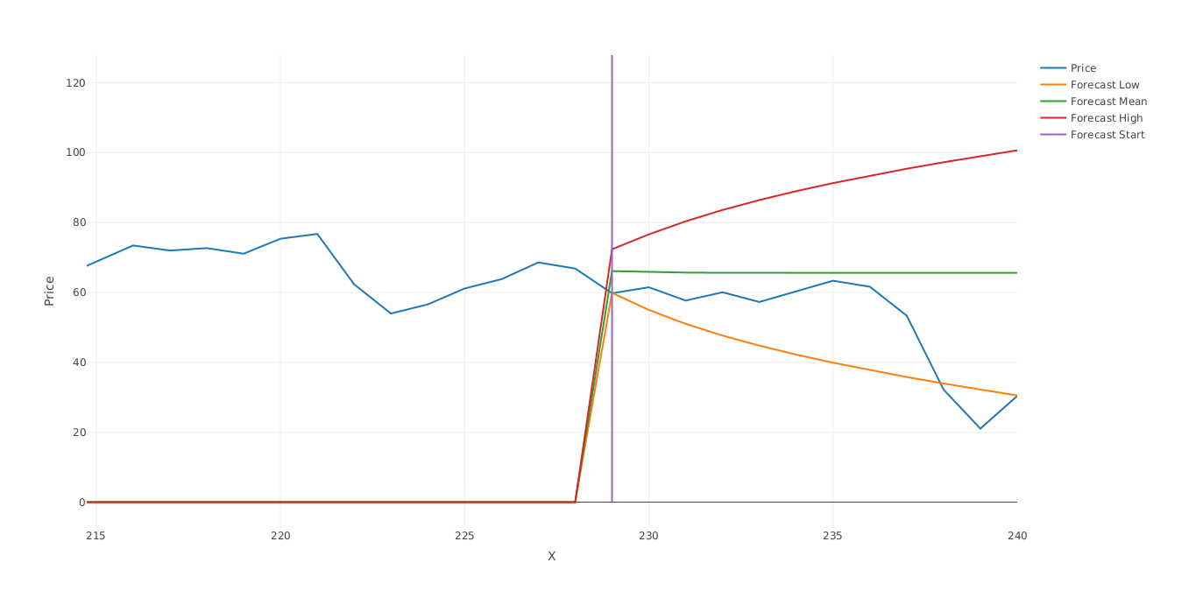

Forecasting with Arima
RSME | 19.92
MAE | 14.11
MAPE | 44.01

Slide 11
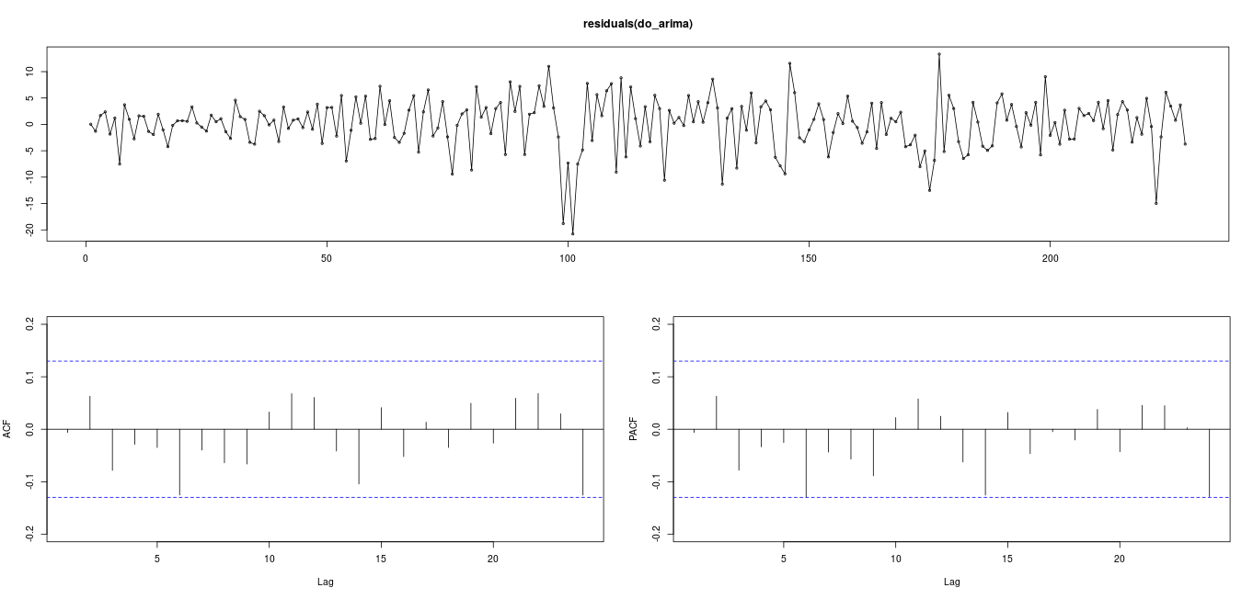
Forecasting with Arima

Slide 12
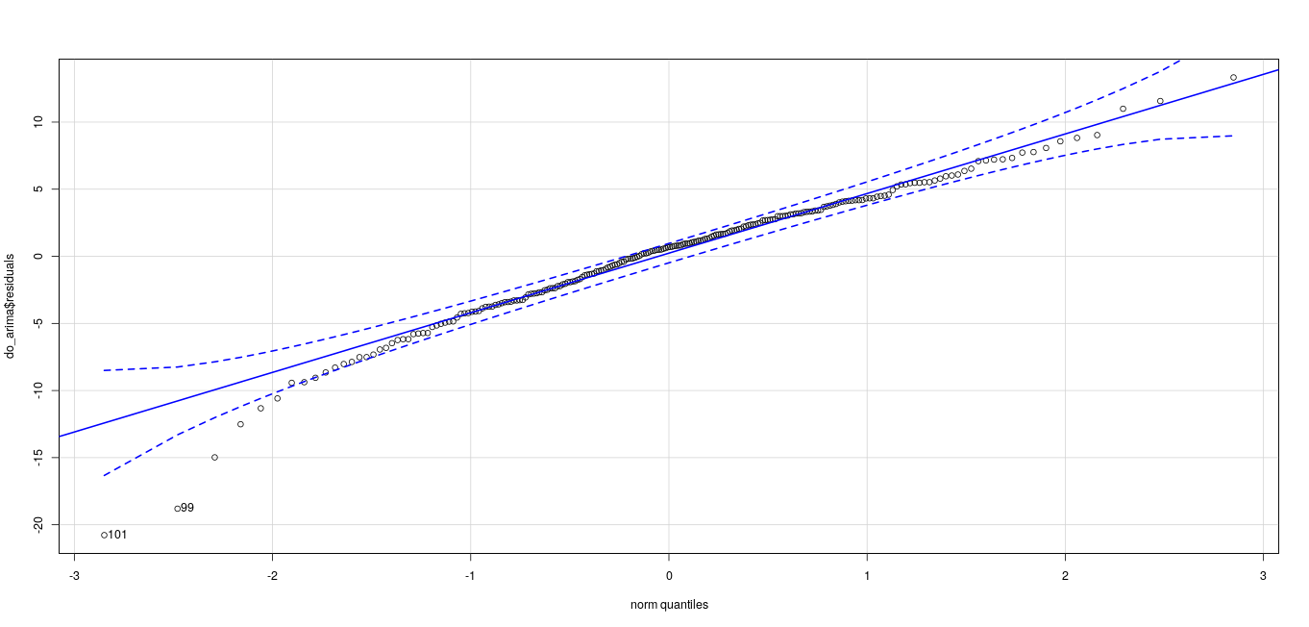
Forecasting with Arima

Slide 13
Thank you
Github: https://github.com/srinathganesh1/Data-Riders/tree/master/CrudeOil
Website: https://datariders.wixsite.com/datarider

